Slide 1
Presentation for SETDA
June 25st 2017

Slide 2
Live Well. Teach Well
Agenda
Philosophy
Content
Software
Pilot
Revenue Model

Slide 3
Philosophy
Students
Happy and healthy educators improve student outcomes. Teacher’s difficulty reaching tech immersed kids is a challenge.
Faculty
Learning is most sustainable when it’s based on theory/research, is multi-modal, and engaging. Engagement is an important element lacking in PD., in part due to technology.
Community
Schools can be the hub of wellness for communities, bringing families and educators together for students

Slide 4
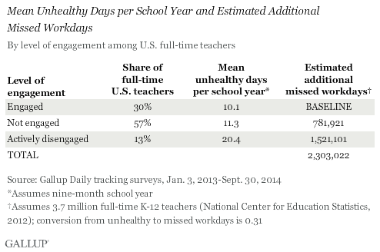
Engagement
WASHINGTON, D.C. -- In the U.S., K-12 schoolteachers who are "not engaged" or are "actively disengaged“ at work miss an estimated 2.3 million more workdays than teachers who are "engaged" in their jobs.

Slide 5
Philosophy: Engagement
Melissa is a H.S. English Teacher of 27 years
Imagine what it would be like if your district could reduce expenses, generate a new revenue stream, improve the quality of education, make parents happier and much more...

Slide 6
Content
1
2
3
4
5
Top experts in every field from wellness to work
Use of high stimulation delivery methods
Brief clusters of time sensitive learning
Self- selection allows for greater autonomy
Create your own content savings schools time/money
Combine individual wants and organizational needs.
With the help of an expert consultant to create a shared picture of success.
The Education Industry is nearly one trillion dollars with 80 billion going to Education Businesses.
IT’S TIME FOR SCHOOLS TO BENEFIT FINANCIALLY!

Slide 7
Five Areas of Focus for PD?
1
2
3
4
5
Academic Skills/Theory/Technique
Mandates
Engagement
Behavioral Health
Systemic and Organizational Dynamics
Over 70% of teacher report feeling disengaged at work (Gallup, 2016)
What would it look like if your faculty were even more engaged?
28% would feel more satisfied and more loyal with options to improve their health and lifestyle.
How would your student learning be impacted by healthier faculty?

Slide 8
Family, Relationships & Self
When a student comes to school stressed, their learning is impacted.
When a teacher comes to school stressed, their teaching is impacted.
Parenting Skills
Communication Skills
Managing Stress
Dealing with Anxiety
Conflict Resolution
Eliminate Addictions
Building Health
Financial Help
Improving Intimacy
Retirement
PERSONAL GROWTH

Slide 9
Skills, Mandates & Engagement
Request an engagement to meet the specific needs of your school
or create your own unique training for your district and beyond
Bullying/ Cyberbullying Prevention
Bloodborne Pathogens
Classroom Management
Education Legal Fluency
Mindfulness Based Teaching
Dealing with Difficult Families
New Teacher Orientation
Process Mentoring
Suicide Prevention
Understanding Learning Disabilities
Teacher Leadership
PROFESSIONAL DEVELOPMENT

Slide 10
Sample Engagements
Imagine what it would be like if your district could reduce expenses, generate a new revenue stream, improve the quality of education, make parents happier and much more...

Slide 11
Learning Communities
Districts can create their own webinars or engagements to save time, money, and personalize their PD.
Educators share
their wisdom and experience with others, creating a true community of learners.
Capitalize on the talents of your faculty and preserve their knowledge even if they move on.
Group interaction with others from inside and outside your district to enhance learning.
Individual, group coaching and webinars for live training online or in person..

Slide 12
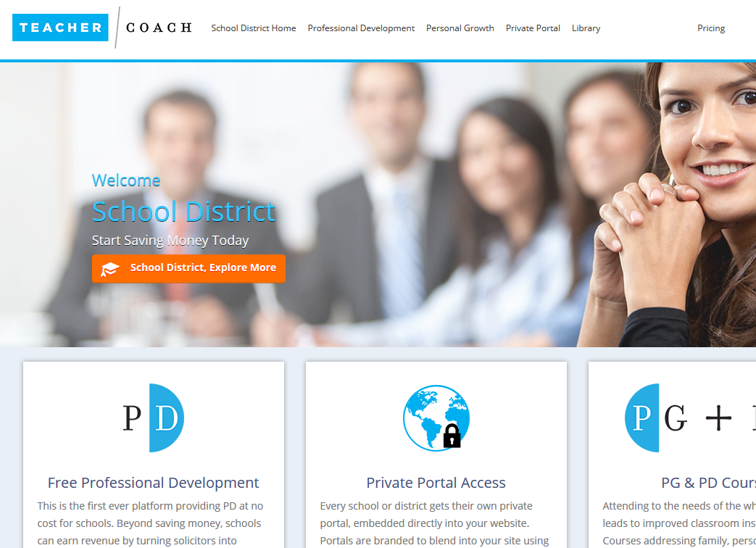
Dedicated District Portals Through the first ever Learning Engagement System (LES)
Software

Slide 13
NJ Teacher’s Survey
97%
91%
AGREE
AGREE
Adding personal growth to professional development is appealing
Individual and group coaching options is appealing
TeacherCoach is an excellent way for administrators to provide necessary professional development, and it gives life to those "boring" topics that are an annual must! The variety of topics offered allows teachers to govern their own professional development. This is so important because who better knows what you need in order to grow than yourself. The best part is that the topics help teachers with not only their professional growth but their personal growth as well. TeacherCoach is an excellent tool to allow schools to save money on professional development while also making money just for utilizing the resources.
ASIA MICHAEL DIRECTOR OF CURRICULUM OF SPRINGFIELD SCHOOL DISTRICT

Slide 14
NJ Teacher’s Survey
84%
93%
AGREE
AGREE
This new type of PD is preferable to our existing service
It’s important having more freedom to select my PD
The course content was thorough and informative.
BASS RIVER TOWNSHIP 1st GRADE TEACHER
The content was excellent.
DELANCO 3rd GRADE TEACHER

Slide 15
NJ Teacher’s Survey
83%
96%
AGREE
AGREE
The PG+PD model would improve my work as an educator
A teacher’s health and wellness at home impacts work in the classroom
Dr. Scherz provided my district with an engaging, impactful and personalized workshop. The teachers involved not only enjoyed their brief time with Dr. Scherz, but asked to have him back next year in order to build upon his presentation. The knowledge and experience he brings to a "live" presentation are readily seen in the TeacherCoach professional development modules. With pertinent information presented in a fun manner that is just the right length of time (not too short as to withhold relevant information but not too long to lose the audience's interest), the Teacher Coach platform will be a welcome addition to Springfield's professional development offerings. Dr. Scherz is a true professional and his commitment to giving back to the education profession is admirable.
CRAIG VAUGHN SUPERINTENDENT OF SPRINGFIELD SCHOOL DISTRICT

Slide 16
NJ Teacher’s Survey
OVER 30% REPORT HIGH AND 77% MODERATE DAILY STRESS
DAILY STRESS
Very Low
Moderate
Very High
Low
High
Extremely High
Dr. Scherz created online PD that is much more engaging than what we have experienced with other online PD providers. Dr. Scherz also provided us in-person PD which was SO well-received by our staff! Both his online and in-person PD were wonderful enhancements to our district, and we are grateful for his dedication to helping schools improve the ways they serve teachers and students. We recommend him highly to any district looking to enhance professional development opportunities for educators!
BRIANNA CHAPIN CURRICULUM DIRECTOR SOUTHAMPTON SCHOOL DISTRICT

Slide 17
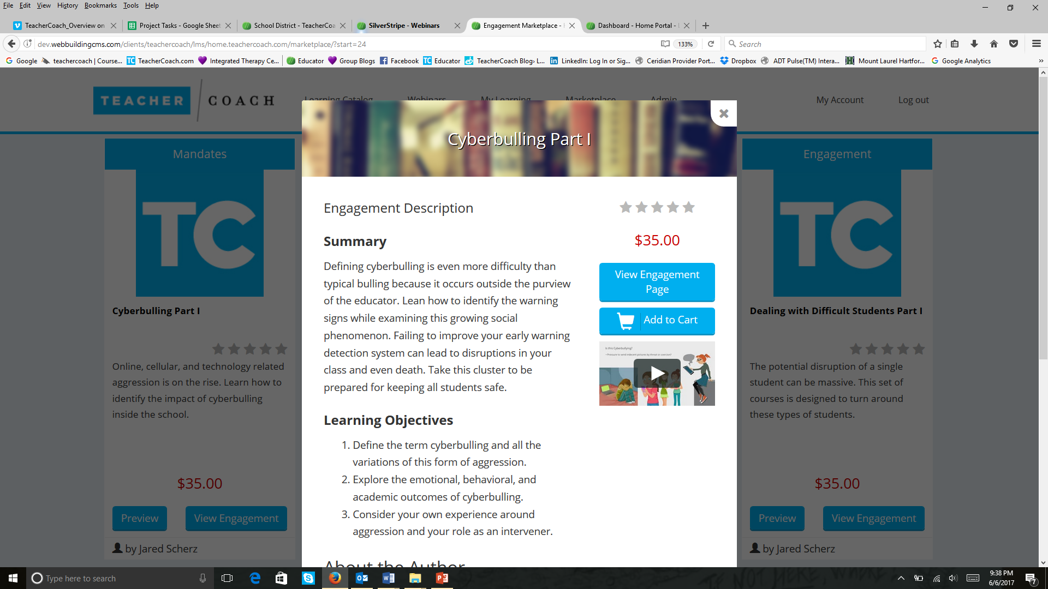
Revenue Sharing Model TURN SOLICITORS INTO SPONSORS TO SAVE TIME & EARN MONEY
Generate Income
The Education Industry is nearly one trillion dollars with 80 billion going to Education Businesses.
IT’S TIME FOR SCHOOLS TO BENEFIT FINANCIALLY!

Slide 18
Revenue Sharing Model TURN SOLICITORS INTO SPONSORS TO SAVE TIME & EARN MONEY

Slide 19
Developed by Jared Scherz, Ph.D., M.Ed. NATIONAL EXPERT ON SCHOOLS
A psychologist, author and former school guidance counselor with 25+ years of supporting educators

Slide 20
To watch SETDA Presentation:
https://vimeo.com/223308584
Finalist

